Slide 1
Vulcan Defect Status
April. 05, 2016
Tao Wu, Wen Yi Gao

Slide 2
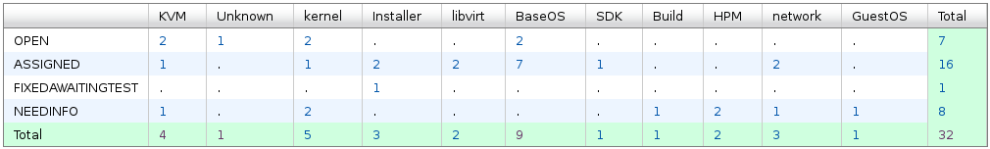
Vulcan - Open Defects
32 open defects exluding 13 HVM bugs.
10 defects new opened in the last two weeks. We solved 6 defects in the past two weeks.
Defect statistics:

Slide 3
Vulcan – High Priority Defects
No |  |  |  | Comp | Summary | Status | Comment
1 | 139769 | P1 | High | BaseOS | Vulcan FP1 chmem command doesn't work in a DPM mode LPAR | ASSIGNED | - Under investigation.
2 | 139772 | P1 | High | BaseOS | chmem -d crashes a Vulcan FP1 system running in a DPM LPAR | ASSIGNED | - Under investigation.
3 | 135658 | P2 | High | network | Getting Tainted Kernel messages against openvswitch - specific to ovs-gre guests | ASSIGNED | - Will be documented.

Slide 4
Vulcan – All Defects
428 defects excluding 13 HVM defects opened in the Vulcan Bugzilla until now.

